Slide 1
Minimum number of platforms required for a railway station
PROBLEM STATEMENT :
You are given arrival and departure time of trains reaching to a particular station. You need to find minimum number of platforms required to accommodate the trains at any point of time.

Slide 2
The arrival time and departure time is in chronological order.
We need to find maximum number of trains that can be on the station with the help of arrival and departure time.

Slide 3
Solution
Compare current element in arrival and departure array and pick smaller one among both.
If element is pick up from arrival array then increment platform_needed.
If element is pick up from departure array then decrement platform_needed.
While performing above steps, we need track count of maximum value reached for platform_needed.
In the end, we will return maximum value reached for platform_needed.
Time complexity : O(NLogN)

Slide 4
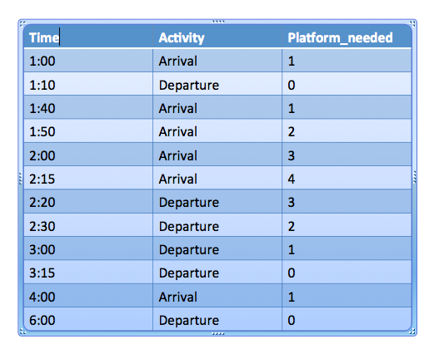
arrival[] = {1:00, 1:40, 1:50, 2:00, 2:15, 4:00} departure[] = {1:10, 3:00, 2:20, 2:30, 3:15, 6:00} No. of platforms required in above scenario = 4

Slide 5
int platform_needed = 0, maxPlatforms = 0;
int i = 0, j = 0;
while (i < n && j < n)
{
if (arr[i] < dep[j])
{
platform_needed++;
i++;
if (platform_needed > maxPlatforms)
maxPlatforms = platform_needed;
}
else
{
platform_needed--;
j++;
}
}

Slide 6
Hashtable vs HashMap:
Parameter | Hashtable | HashMap
ThreadSafe | Yes | No
Synchronized | Yes | No
Performance | Due to theadSafe and Synchronized,it is often slower than HashMap | In single threaded environment, it is much faster than Hashtable.So if you do not work in multi thread environment ,then hashMap is recommended
Null key | Do not allow null key | Allows null key as well as values
Fail fast | enumeration in hashtable is not fail fast | Iterator in hashMap is fail fast
Extends | It extends Dictionary class which is quite old | It extends AbstractMap class

